Slide 1
Confessions of a successful project
@OndrejBalas

Slide 2


Ondrej Balas
Husband. Father. Geek.
Owner of UseTech Design
I build software that drives business
Blog: http://www.ondrejbalas.com Twitter: @OndrejBalas

Slide 3


Slide 4


Slide 5



Slide 6
Define Success
Requirements are completed
On time
Under budget
Maintainable codebase

Slide 7

Notes:
What really matters

Slide 8
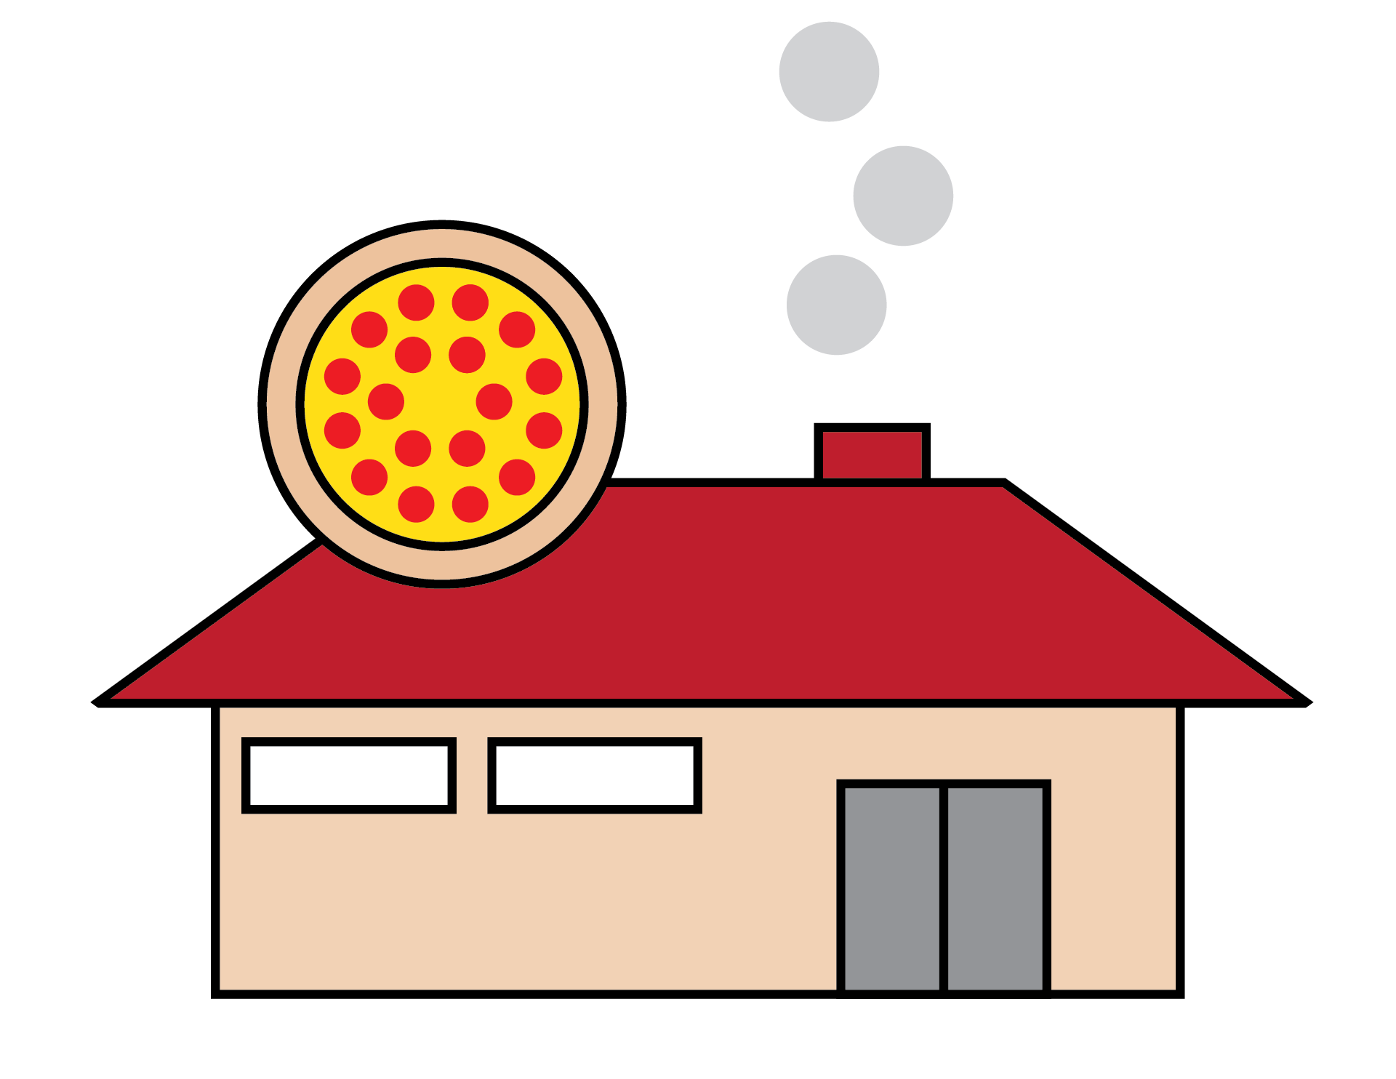


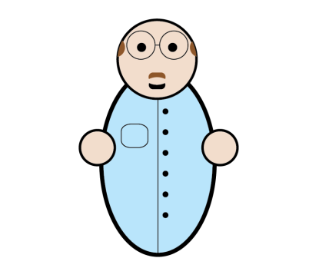
A Fictional Project

Slide 9
Customer: Big Al’s Pizza
Big Al

Slide 10
Gathering
Requirements

Slide 11

Lucy (Business Analyst)

Slide 12
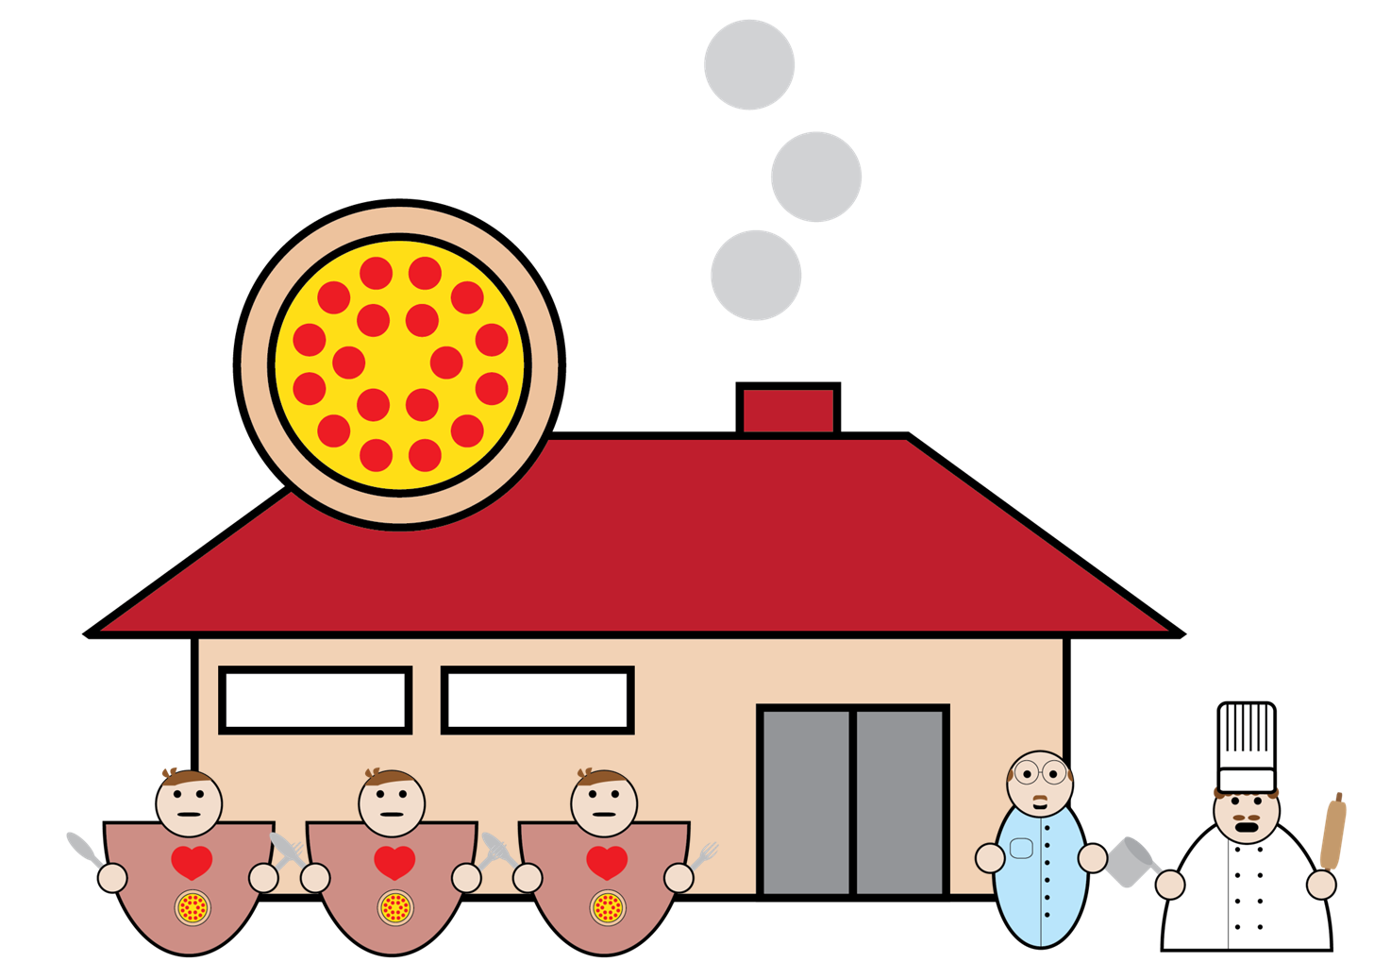

Slide 13
Notes:
Lucy and Pizzeria moved

Slide 14


Slide 15

Notes:
Lucy moved, Developers came in from the right side

Slide 16
Becky Nathan James (Developers)

Slide 18
Notes:
Paper moved

Slide 19
Notes:
Paper moved

Slide 20
Notes:
Lucy moved while holding paper

Slide 21
Notes:
Paper moved

Slide 22
Notes:
Paper moved

Slide 23
Notes:
Lucy moved while holding paper

Slide 24
Notes:
Paper moved

Slide 25
Notes:
Paper moved

Slide 26
Notes:
Lucy moved while holding paper

Slide 27
Notes:
Paper moved

Slide 28
Notes:
Paper moved

Slide 29
Notes:
Lucy moved while holding paper

Slide 30
Notes:
Paper moved

Slide 31
Notes:
Paper moved

Slide 32
So what went wrong?

Slide 33
User Stories
Represent a requirement
Should be from the user’s point of view
Should be non-technical

Slide 34


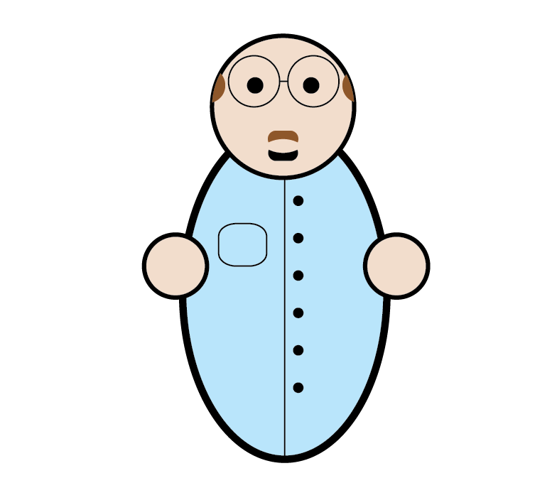

Steve

Slide 35


Slide 36
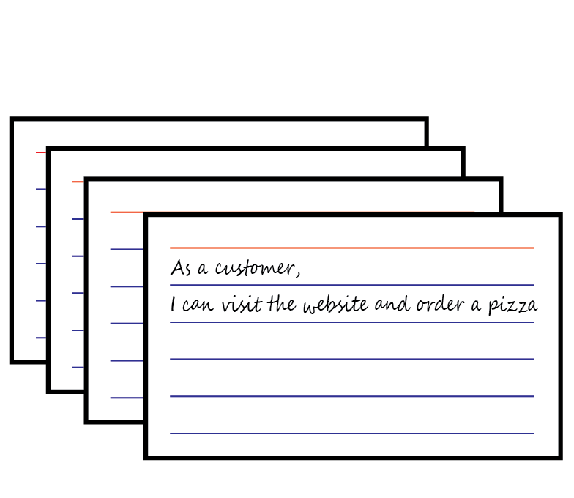

Slide 37
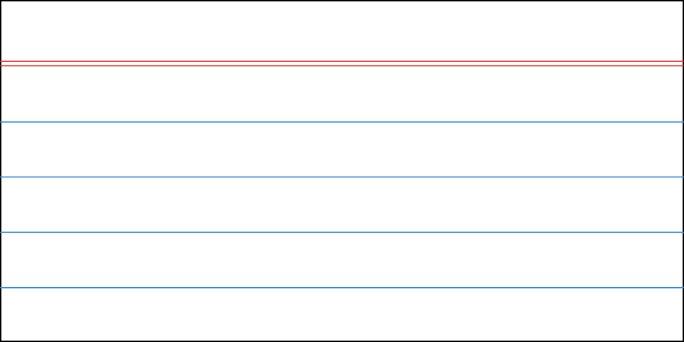
As an online customer,
I can place an order through the website

Slide 38
As the store manager,
I can see how many customers are waiting for their pizza

Slide 39
As the pizza chef,
I can see which pizzas need to be made

Slide 40
This story is too ambiguous
X
As an online customer,
I can easily figure out how to use the website

Slide 41
This story is too big
X
As the store manager,
I can manage the entire store from the application

Slide 42
This story has no value to a user
X
As the developer,
I should write the application in C#

Slide 43
As Charlie (the online customer),
I would like to have an estimate of when the pizza will be ready, So that I know when to expect it

Slide 44
As Steve (the store manager),
I can set the employee schedules,
So that I can have my best workers in during the busiest times

Slide 45
As Big Al (the pizza chef),
I can see how long each order has been in the queue,
So that customers don’t wait too long for their pizzas

Slide 46
Estimating

Slide 48


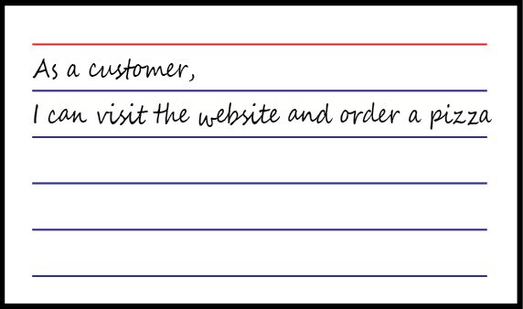



Paul
4 Hours
4!? I can do it in 2!
3
Uhh..

Slide 49
4 Hours
4!? I can do it in 2!
3
7
9
Uhh..
Notes:
Card moved from stack to Paul

Slide 50
4 Hours
4!? I can do it in 2!
Uhh..
3
3
3
20
6
2
9
14
3
Notes:
Card moved from stack to Paul

Slide 51
There is a better way!
Actually, I’ll show you two…

Slide 52
Planning Poker

Slide 53


Slide 54




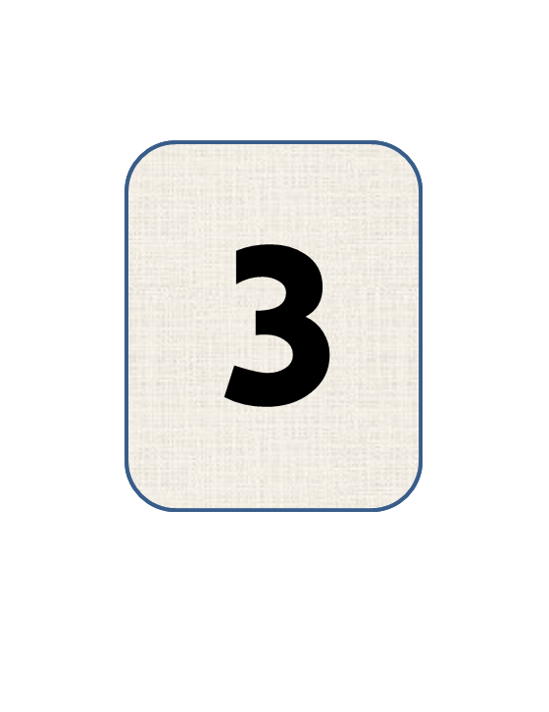








Slide 55
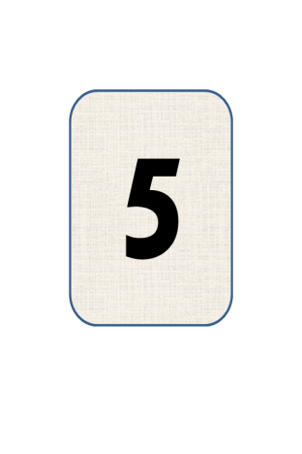
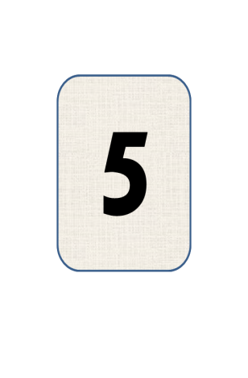

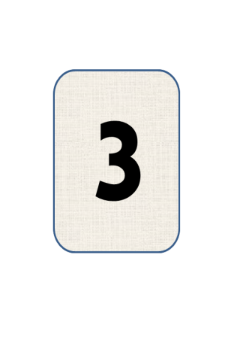
20

Slide 56
Another option

Slide 57
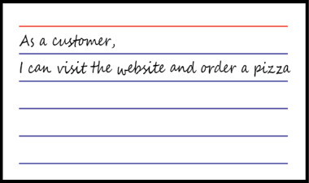
Another option

Slide 62
13
2
5
20
8

Slide 63
But … where’s the estimate?

Slide 64
Assigning Work

Slide 65
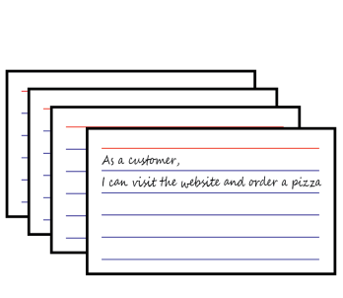

Slide 66
Notes:
Card stack copied and copy moved to Becky

Slide 67
Notes:
Becky leaves screen (down). Other developers move closer to Paul in the same time.

Slide 68

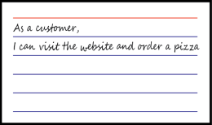
I’m blocked
I can help!

Slide 69
Sure!
Me too.
Help?

Slide 70
Welp.
Lunch?
Ahhh!
Let’s go!

Slide 71
No one can see what anyone else is working on

Slide 72
Kanban
Visualize your work

Slide 73
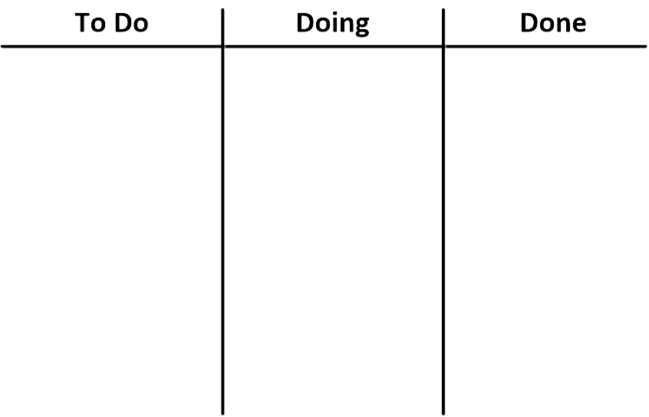

Slide 74


Slide 77
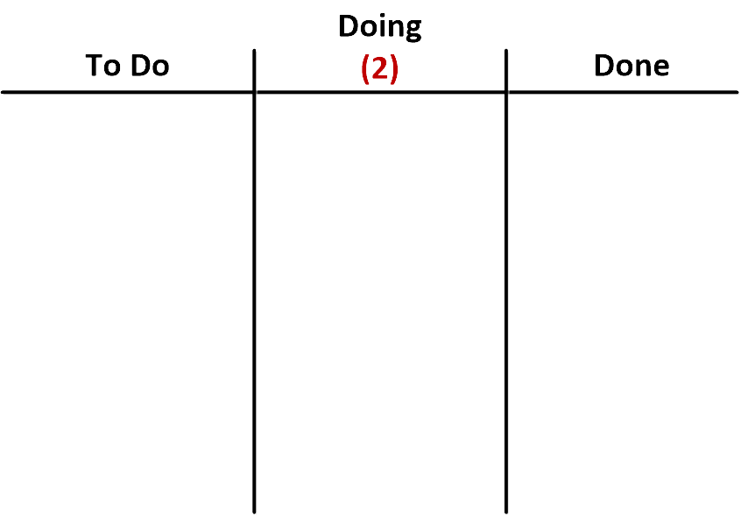
Notes:
No animation on this slide. This is a ‘new board’

Slide 78
Notes:
No animation on this slide. This is a ‘new board’

Slide 79
Notes:
No animation on this slide. This is a ‘new board’

Slide 80
Notes:
No animation on this slide. This is a ‘new board’

Slide 81
Notes:
No animation on this slide. This is a ‘new board’

Slide 82
Notes:
No animation on this slide. This is a ‘new board’

Slide 83
Notes:
No animation on this slide. This is a ‘new board’

Slide 84
Notes:
No animation on this slide. This is a ‘new board’

Slide 85
Notes:
No animation on this slide. This is a ‘new board’

Slide 86
Notes:
No animation on this slide. This is a ‘new board’

Slide 87
Notes:
No animation on this slide. This is a ‘new board’

Slide 88
Notes:
No animation on this slide. This is a ‘new board’

Slide 89
Notes:
No animation on this slide. This is a ‘new board’

Slide 90
Limiting Work in Progress (WIP)
Helps avoid costly context-switching
Features are completed quicker
Keeps velocity more fluid
Testers get a more constant stream of work

Slide 91
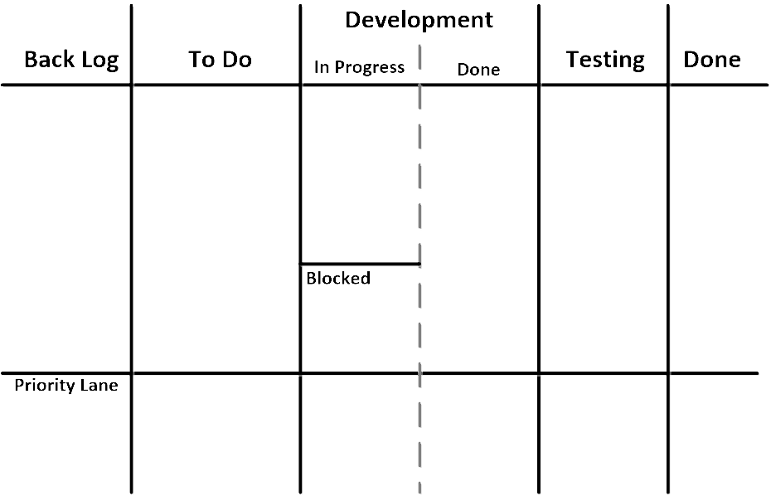

2

Slide 92
2
Notes:
8 notes from Back Log to To Do

Slide 93
2
Notes:
2 notes from To Do to In Progress

Slide 94
2
Notes:
1 note from In Progress to Done

Slide 95
2
Notes:
1 note from To Do to In Progress

Slide 96
2
Notes:
1 note from Done to Testing

Slide 97
2
Notes:
1 note from In Progress to Blocked

Slide 98
2
Notes:
1 note from To Do to In Progress

Slide 99
2
Notes:
1 note from Testing to Done

Slide 100
2
Notes:
2 notes from In Progress to Done

Slide 101
2
Notes:
1 note from To Do to In Progress
1 note from Blocked to In Progress
1 note from Done to Testing

Slide 102

2

Slide 103
2
Notes:
Pink note from To Do to In Progress

Slide 104
2
Notes:
Pink note from In Progress to Done

Slide 105
2
Notes:
1 note from Testing to Done
1 note from Done to Testing
Pink note from Done to Testing

Slide 106
2
Notes:
1 note from In Progress to Done
1 note from To Do to In Progress
Pink note from Testing to Done

Slide 107
2
Notes:
1 note from Testing to Done
1 note from Done to Testing
2 notes from To Do to In Progress

Slide 108
2
Notes:
1 note from Testing to Done
1 note from Done to Testing
1 note from In Progress to Done

Slide 109
2
Notes:
1 note from Testing to Done
1 note from Done to Testing

Slide 110
2
Notes:
1 note from Testing to Done
1 note from Done to Testing
1 note from In Progress to Done

Slide 111
2
Notes:
1 note from Testing to Done
1 note from Done to Testing

Slide 112
2
Notes:
1 note from Testing to Done

Slide 113
Tracking Progress

Slide 114
Burn-Down Chart
Effort Remaining
Time

Slide 115
Burn-Down Chart
Effort Remaining
Time

Slide 116
Burn-Down Chart
Effort Remaining
Time

Slide 117
Burn-Down Chart
Effort Remaining
Time

Slide 118
Burn-Down Chart
Effort Remaining
Time

Slide 119
Burn-Down Chart
Effort Remaining
Time

Slide 120
Burn-Down Chart
Effort Remaining
Time

Slide 121
Burn-Down Chart
Effort Remaining
Time

Slide 122
Burn-Down Chart
Effort Remaining
Time

Slide 123
Burn-Down Chart
Effort Remaining
Time

Slide 124
Burn-Down Chart
Effort Remaining
Time

Slide 125
Burn-Down Chart
Effort Remaining
Time

Slide 126
Burn-Down Chart
Effort Remaining
Time

Slide 127
Burn-Down Chart
Effort Remaining
Time

Slide 128
Burn-Down Chart
Effort Remaining
Time

Slide 129
Burn-Down Chart
Effort Remaining
Time

Slide 130
Burn-Down Chart
Effort Remaining
Time

Slide 131
Burn-Down Chart
Effort Remaining
Time

Slide 132
Burn-Down Chart
Effort Remaining
Time

Slide 133
Burn-Up Chart
Effort
Time

Slide 134
Burn-Up Chart
Effort
Time

Slide 135
Burn-Up Chart
Effort
Time

Slide 136
Burn-Up Chart
Effort
Time

Slide 137
Burn-Up Chart
Effort
Time

Slide 138
Burn-Up Chart
Effort
Time

Slide 139
Burn-Up Chart
Effort
Time

Slide 140
Burn-Up Chart
Effort
Time

Slide 141
Burn-Up Chart
Effort
Time

Slide 142
Burn-Up Chart
Effort
Time

Slide 143
Burn-Up Chart
Effort
Time

Slide 144
Burn-Up Chart
Effort
Time

Slide 145
Burn-Up Chart
Effort
Time

Slide 146
Burn-Down Chart
Effort Remaining
Time

Slide 147
Burn-Up Chart
Effort
Time

Slide 148
Burn-Up Chart
Effort
Time

Slide 149
Burn-Up Chart
Effort
Time

Slide 150
Burn-Up Chart
Effort
Time

Slide 151
Burn-Up Chart
Effort
Time

Slide 152
Burn-Down Chart
Effort Remaining
Time

Slide 153
Burn-Up Chart
Effort
Time

Slide 154
Burn-Up Chart
Effort
Time

Slide 155
Burn-Up Chart
Effort
Time

Slide 156
Burn-Up Chart
Effort
Time

Slide 157
Burn-Up Chart
Effort
Time

Slide 158
Burn-Down Chart
Effort Remaining
Time

Slide 159
Burn-Up Chart
Effort
Time

Slide 160


Kanban Tools
Trello.com
Kanbanize.com

Slide 161
Thanks!
Questions? E-mail or Tweet me
ondrej@ondrejbalas.com
@OndrejBalas

